Slide 1


Notes:
At the end of each session share with us your feedback through the Laerdal SUN app. We rely on you to make this SUN better each time.

Slide 2
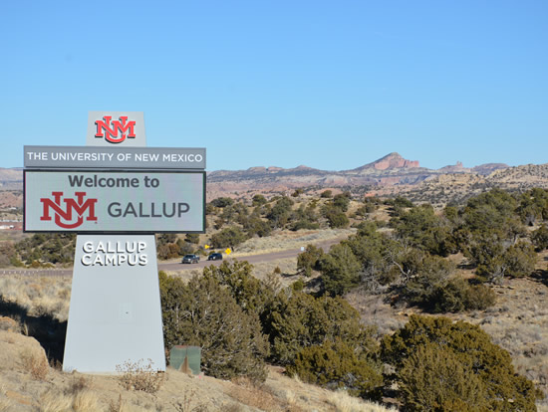
Welcome
The University of New Mexico-Gallup Campus Mini-SUN

Slide 3

Where:
University of New Mexico – Gallup
705 Gurley Ave
Gallup, NM 87301

Slide 4
Agenda
9:00 – 9:30 AM Welcome – Student Services and Tech. Center 200 (SSTC 200) Lobby
9:30 – 10:00 AM Introduction – Student Services and Tech. Center 200 (SSTC 200) with Jonathan Lumibao
10:00 – 11:00 AM Session # 1
SSTC 200 – Overview of Simulation Standards – Core Four (Pre-briefing, Facilitation, Debriefing, and Professional Integrity) with Matthew Kosemund, CHSOS
11:00 – 11:15 AM Break
11:15 – 12:15 PM Session # 2
SSTC 200 – Better Debriefing: Techniques of Debriefing for Novice with Matthew Kosemund, CHSOS
12:15 – 1:15 PM Lunch and Networking – Student Services and Tech. Center 200 (SSTC 200)

Slide 5
Agenda
1:15 – 2:15 PM Session # 3
Virtual – Student Services and Tech. Center 200 (SSTC 200) Low-cost/Cost Effective Simulation Solutions with Kelly McKeever, Virtual Education and Content Development Specialist
2:15 – 2:30 PM Break
2:30 – 2:45 PM Session # 4
  High Impact-Low Resource Solutions for Quality Care From Laerdal Medical – Student Services and Tech. Center 200 (SSTC 200) with Steph Evans
2:45 – 3:00 PM Closing

Slide 6
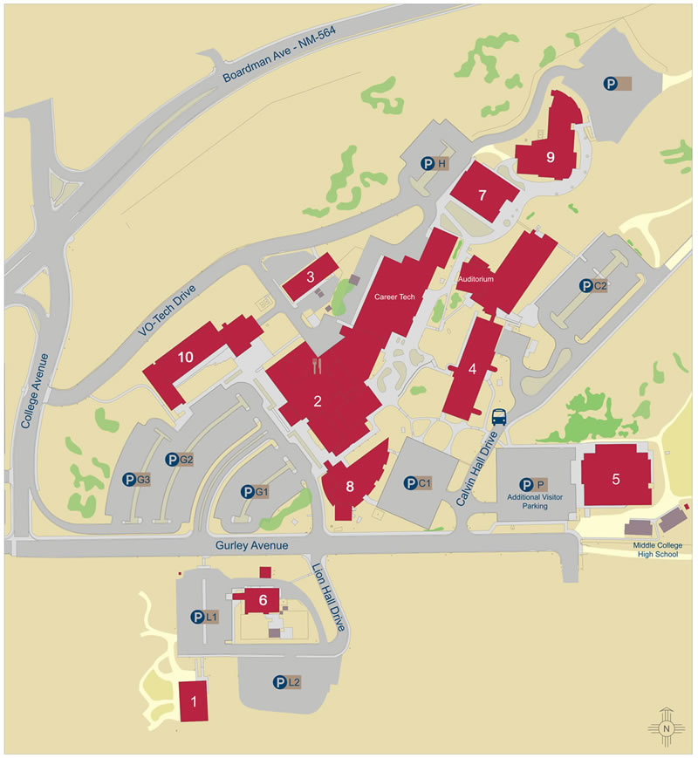


Campus Map
1. Food Service Lions Hall
2. Gurley Hall
3. Construction Technology
4. Calvin Hall Center
5. Physical Education Complex
6. Physical Plant
7. Health Careers Center I
8. Zollinger Library
9. Health Careers Center II / Nursing
* 10. Student Services and Tech. Center

Slide 7
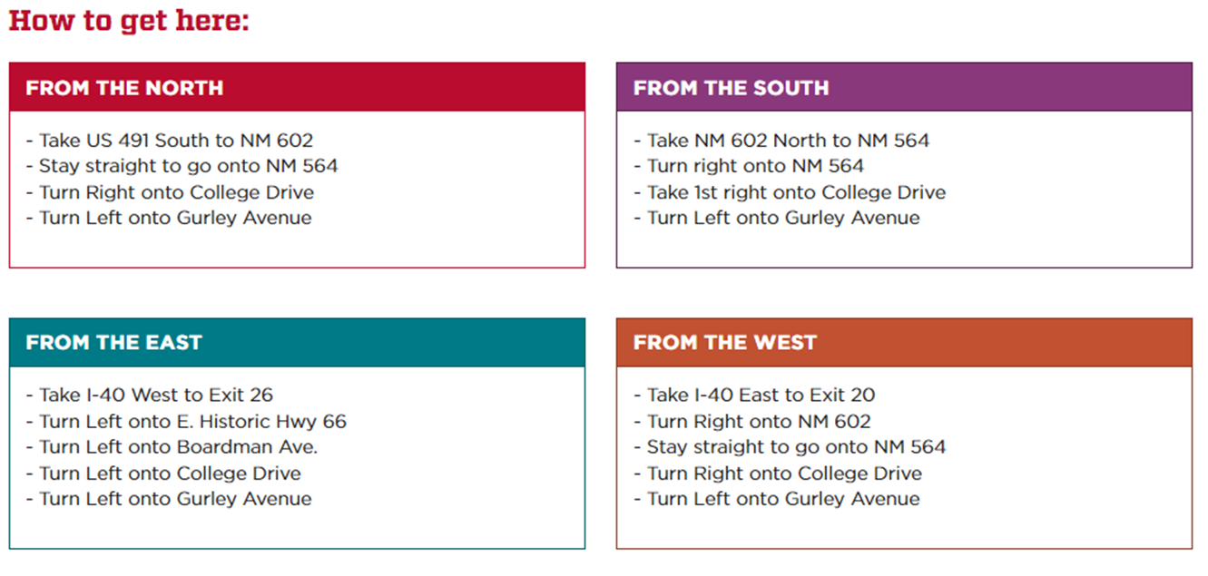
Campus Directions

Slide 8
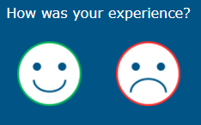

Conference Survey
  Help us make the
  SUN Conferences
  best meet your needs.
  Please give us your feedback

Slide 9
Notes:
At the end of each session share with us your feedback through the Laerdal SUN app. We rely on you to make this SUN better each time.

